Slide 1
A Glance of Major Cities in Canada
- A Tourist’s Point of View

Slide 2
Business Problem | Inspiration
As a tourist visiting Canada for the first time, the major cities Toronto, Vancouver and Ottawa are on my list.
While planning my trip, I want to learn about the cities on the high level so I know what to expect, and what to focus on in each city.
Downtowns: How similar/dissimilar are the downtowns?
Neighborhoods: What are the different neighborhoods in each city?
Food Selection: What are the most popular cuisines in each city?
To-do: What are the most popular recreational activities in each city?
Other: What are some of the unique characteristics of each city?

Slide 3
Business Problem | Generalization
Once packaged as a product, this can be a custom trip planning service
The customer can select the cities they want to visit (rather than most of the current travel sites that provide plans for only fixed combination of cities)
Rather than just giving out plans, compare and contrast the cities from various perspective to give travelers more background information. Travelers can then refine their plans to include/exclude, or increase/reduce time in certain cities based on what they see and what interest them
In each categories (such as food, culture, activities), customers can have an overview of what’s most popular and what’s most unique to each city, so that they can prioritize based on their own interests.

Slide 4
Data | What’s Needed
To Achieve this, the following data will be used
Data that contains the zip code and neighborhood information of Toronto, Vancouver, and Ottawa.
Latitude and Longitude information by zip code
Foursquare data that contains venue information in the 3 cities

Slide 5
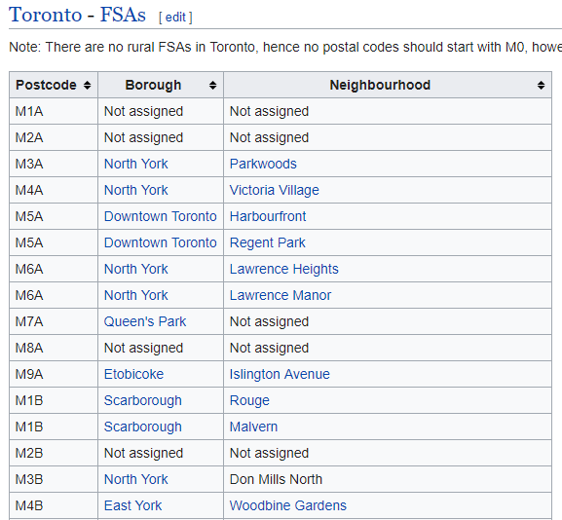
Data | Zip Code - Neighborhood
For Toronto, there’s a well-formatted data source that contains zip code – neighborhood information: https://en.wikipedia.org/wiki/List_of_postal_codes_of_Canada:_M
Some processing and cleansing is needed for missing data

Slide 6
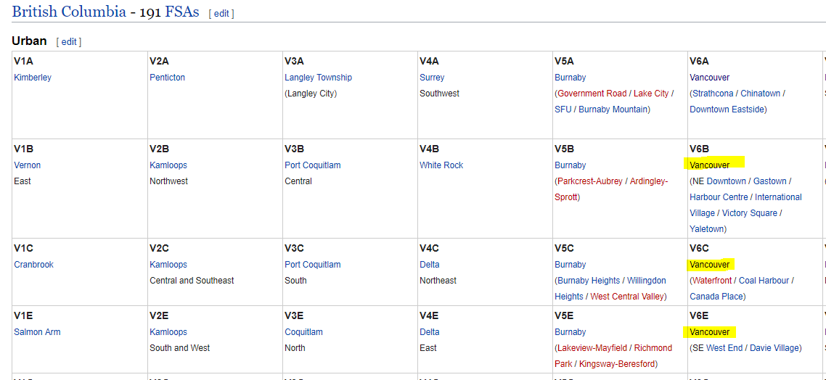
Data | Zip Code - Neighborhood
For Vancouver and Ottawa, more data processing is needed
Vancouver: https://en.wikipedia.org/wiki/List_of_postal_codes_of_Canada:_V
Ottawa: https://en.wikipedia.org/wiki/List_of_postal_codes_of_Canada:_K
Data is not organized in the format we need, some processing is required
Some cleansing is needed for missing data and irrelevant data (for the screenshot shown, need to limit to Vancouver data only)

Slide 7
Data | Coordinates
Use the Geocoder Python package to obtain coordibates data for each Zip Code:
import geocoder # import geocoder
# initialize your variable to Nonelat_lng_coords = None
# loop until you get the coordinates
while(lat_lng_coords is None):
g = geocoder.google('{}, Toronto, Ontario'.format(postal_code))
lat_lng_coords = g.latlng
latitude = lat_lng_coords[0]
longitude = lat_lng_coords[1]

Slide 8
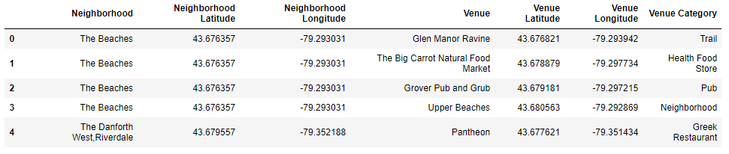
Data | Venue Information
Use Foursquare API to explore venues near each zip codes
Format of API is: https://api.foursquare.com/v2/venues/explore?client_id={}&client_secret={}&ll={},{}&v={}&radius={}&limit={}
Once data is obtained, a cluster analysis will be performed on neighborhoods, to find different neighborhoods in each city.

Slide 9
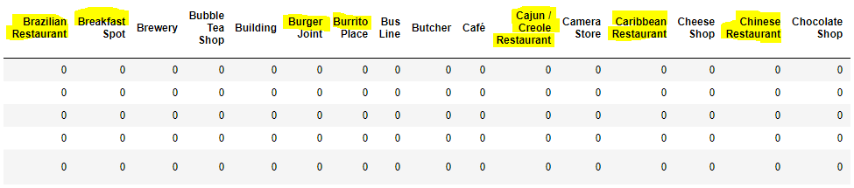
Data | Venue Information
For analysis on “food selection”, “to-do”, and “others”, realized the “category name” of venues are too detailed/granular for the purpose of this analysis
For example, restaurants/food is separated into cuisines and subtypes of cuisines; similar for other categories
Some manual grouping (most likely based on string matches) will be needed
All the highlighted categories are food options, while the detailed breakdown is not necessary.

